Slide 1

Investment Data Visualization A case study using Tableau software
-AKSHAYA SHRIDHARR

Slide 2
LINEUP
To derive insights from the data provided by the client
Expenses
Dashboards
Insights and solutions

Slide 3
EXPENSES
REQUIREMENTS AND ESTIMATE
Windows OS, Tableau Desktop – Available with designer
Data understanding and cleaning – 800 INR
Wireframe Design cost – 1500 INR
Tableau Creator Software - $70 per month (Approx. 5,100 INR)
Working hours rate (8 Hours Includes creating charts and finding insights) – 6800 INR
Miscellaneous chargers – 500 INR
TOTAL EXPENSE – 14,700 INR

Slide 4
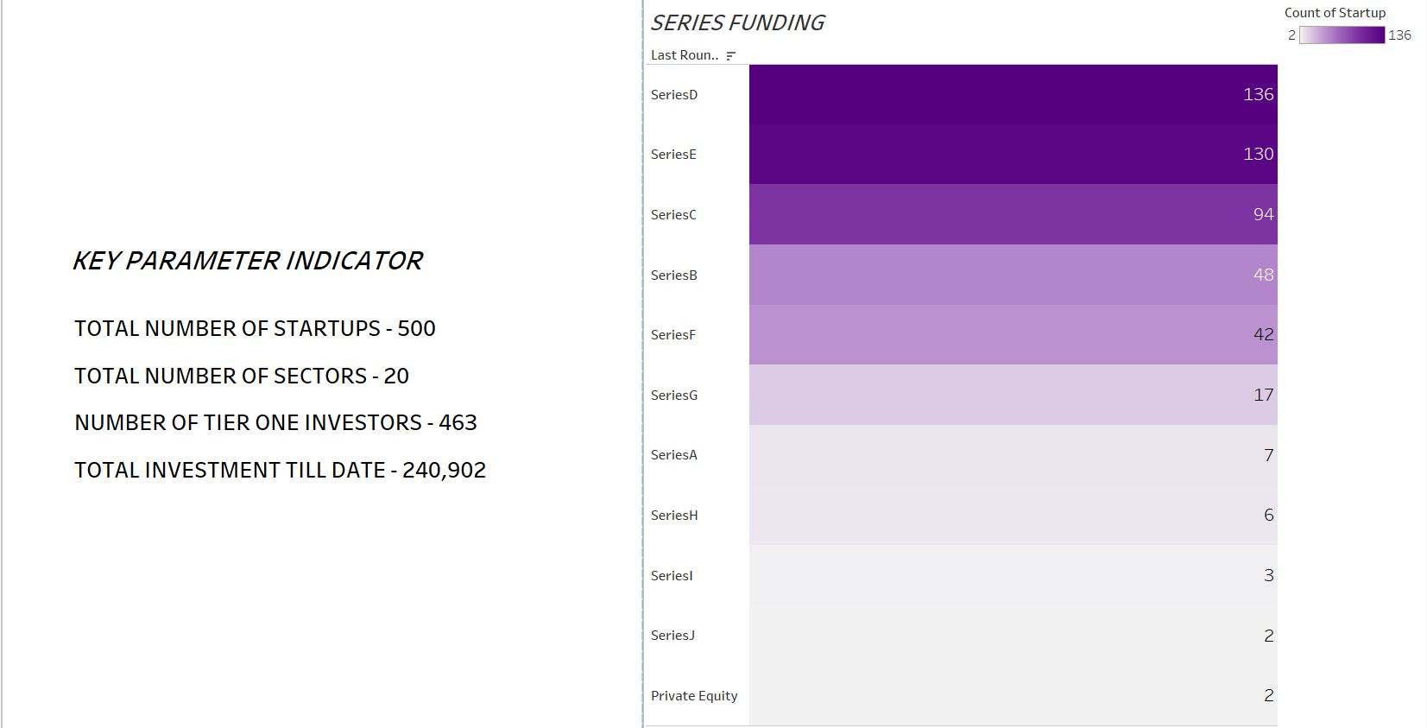

Slide 5
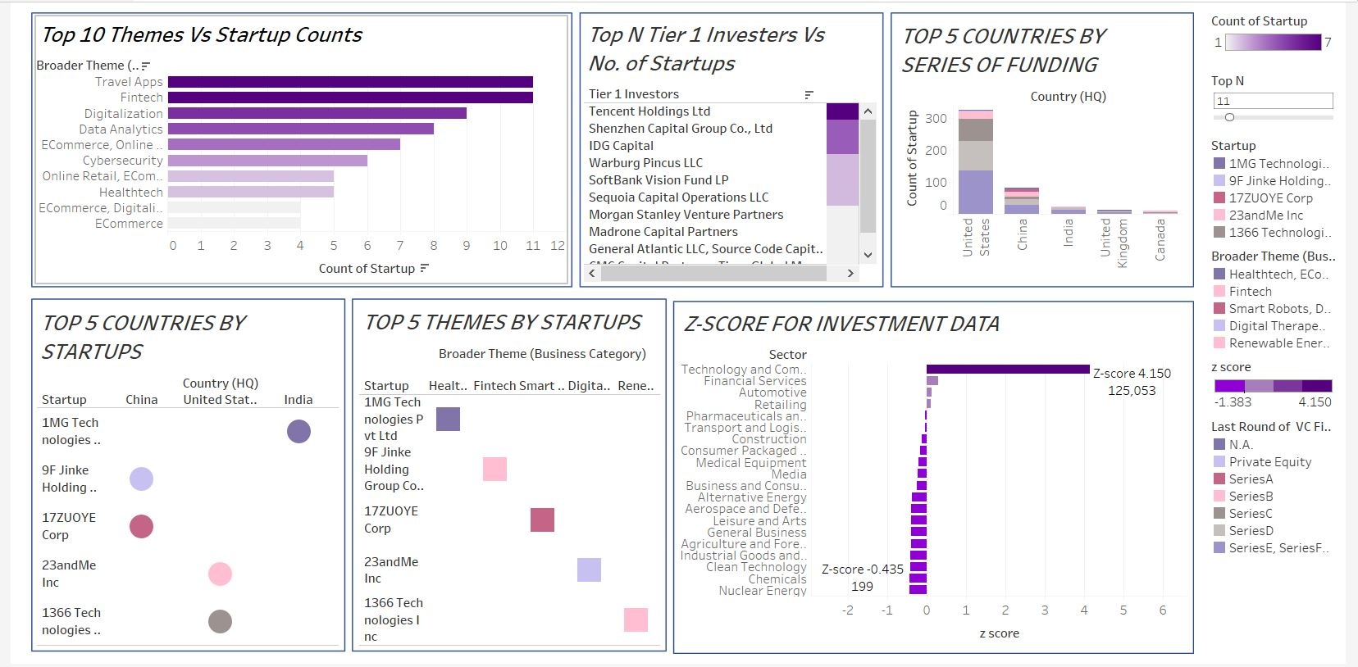

Slide 6
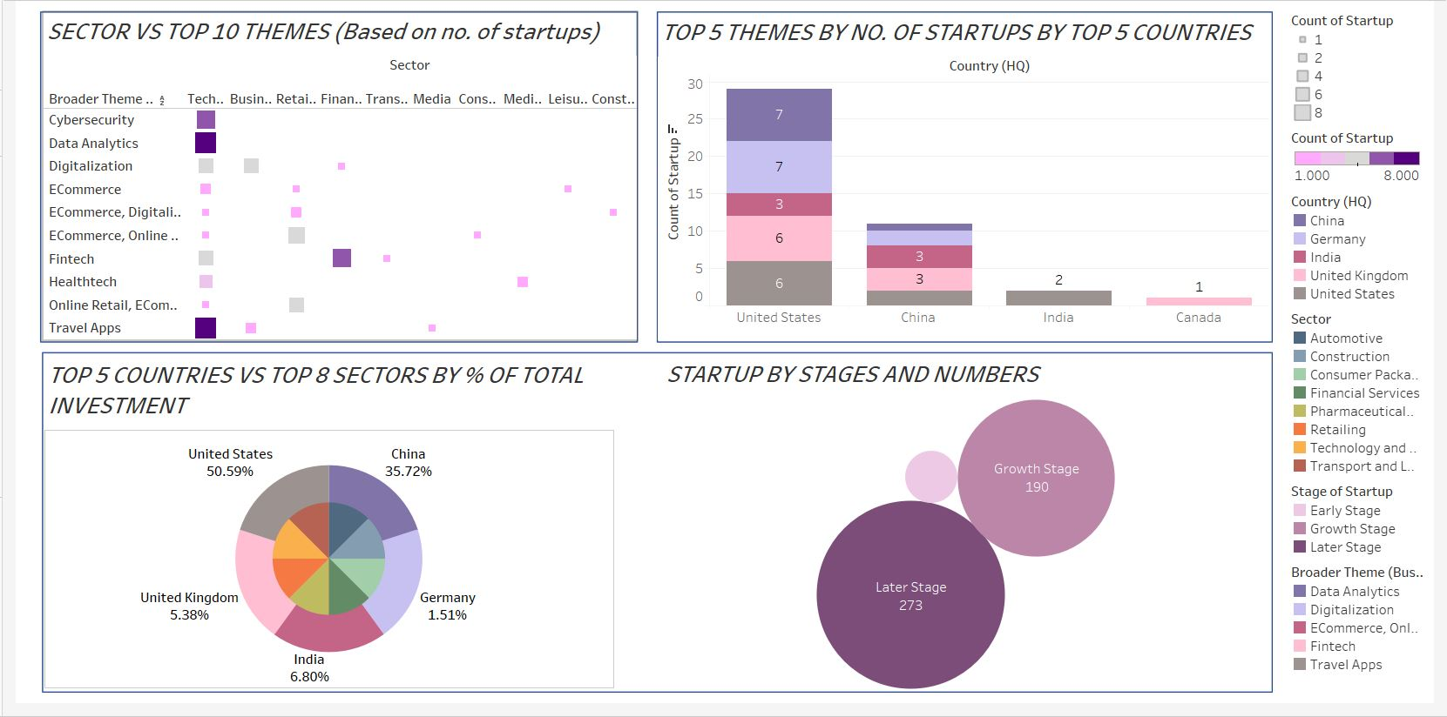

Slide 7
INSIGHTS AND SOLUTIONS
Travel apps and Fintech themes have the maximum number of startups. This shows that travel business is doing good with many vivid travelers. Travel theme will always be on top as people love travelling. People would also like to save as much as money possible, and that’s the reason for Fintech themes to have good number of startups. e-Commerce is also one of the best themes to invest as people prefer buying things with just a phone or an app. Hence, number of e-Commerce startups should be increased. As digitalization is ever going, investing on any online platforms gives you good business.
As we check out the top 5 themes vs countries vs startups, we can figure out that India tops with Healthcare, China with Fintech and Digitalization and USA with Medical and Renewable energy. All these countries have the largest population. Investing on healthcare in India is one of the greatest as the availability of healthcare facilities for the vast population is less.
Analyzing the Altman Z-score for the investment data, it is clear that Technology and communications has a z-score greater than 3 and hence has the least chances for bankruptcy. Buying stocks from this sector is a good move for an investor. Since no sector has z-score less than -3, its still safe to invest on other sectors too.
We can see from the top 10 themes vs sectors based on start ups that technology and communication has the maximum number of start-ups. This also proves that the investors are happy with this sector and gain good profit. Retailing follow next as it plays a huge role in everyone’s day to day life.

Slide 8
INSIGHTS AND SOLUTIONS
A total of 149 startups, 7 in series A, 48 in B and 94 in C. Only 7 startups have reached series A and can have a plan for developing a business model, even if they haven’t proven it yet. Series B have already found their product/market fit and needs help expanding. 94 in series C funding are doing very well and are ready to expand to new markets, acquire other businesses, or develop new products
We can see that about 136 startups are in the series D funding. Many companies finish raising money with their Series C. However, there are a few reasons a company may choose to raise a Series D. They’ve discovered a new opportunity for expansion before going for an IPO, but just need another boost to get there. More companies are raising Series D rounds (or even beyond) to increase their value before going public. Alternatively, some companies want to stay private for longer than used to be common. Each of these are positive reasons to raise a Series D.
The startups that are in series E or above have failed to meet expectations; they want to stay private longer; or they need a little more help before going public.
The United states has invested more than 50% of the total investment on startups till date. This is of no surprise, as we know it’s the top country in the world.
Technology and communication hold about 60% of the total investment till date. It once again proves that it is the best sector to invest on.
Of the 500 total start ups, 273 i.e about approx. 55% are in the later stage, about 38% in the growth stage and 0.04% in the early stage. Most of the startups have been there for quite a long time. It is time to invest on new startups.

